Slide 1
JUnit course
25/10/2023 – Cristian Bulgarelli

Slide 2

1. Introduction
Production-ready software requires testing before it goes into production.
Historically the testing phase has been manual, but this approach has proven to be expensive, error-prone (depending on the level of concentration and lucidity of the tester), and tedious.
Instead of having myriads of manual software testers, development teams have moved towards automating the biggest portion of their testing efforts. Automating their tests allows teams to know whether their software is broken in a matter of seconds and minutes instead of days and weeks.
Cristian Bulgarelli - the source code is available at https://github.com/cBulgarelliAtWork/junit-course

Slide 3
2. Why Testing Matters
Developing automated tests during the code development phase brings the following benefits:
ensures that a given class, containing business logic, has a certain expected behavior in the various possible scenarios; it's a kind of contract
helps identify bugs and prevent them
guarantees a high level of quality of the developed code (if the code is of quality, it will be easy to test it)
ensures that no regressions are introduced over time as existing code is modified to meet new requirements
if associated with tools like maven, it allows you to automatically execute the set of tests developed within each build
Cristian Bulgarelli - the source code is available at https://github.com/cBulgarelliAtWork/junit-course

Slide 4
3. JUnit Overview
JUnit is a useful framework for developing and running unit tests. It has evolved over time, releasing several versions: the latest is 5, codenamed Jupiter.
JUnit 5 = JUnit Platform + JUnit Jupiter + JUnit Vintage
The JUnit Platform serves as a foundation for launching testing frameworks on the JVM.
JUnit Jupiter is the combination of the programming model and extension model for writing tests and extensions in JUnit 5.
JUnit Vintage provides a TestEngine for running JUnit 3 and JUnit 4 based tests on the platform. It requires JUnit 4.12 or later to be present on the class path or module path.
JUnit 5 requires Java 8 (or higher) at runtime. However, you can still test code that has been compiled with previous versions of the JDK.
We will use the latest version of JUnit available, which is Jupiter.
Cristian Bulgarelli - the source code is available at https://github.com/cBulgarelliAtWork/junit-course

Slide 5
4. Getting Started with JUnit
Setting up JUnit in your Java project.
Setting up JUnit 5.x.0 is pretty straightforward; we just need to add the following dependency to our pom.xml:
<dependency>
<groupId>org.junit.jupiter</groupId>
<artifactId>junit-jupiter-engine</artifactId>
<version>5.10.0</version>
<scope>test</scope>
</dependency>
Cristian Bulgarelli - the source code is available at https://github.com/cBulgarelliAtWork/junit-course

Slide 6
To run the junits present in the project, the use of the maven surefire plugin is required. This plugin is automatically available in a maven project, so there's no need to configure it. Anyway, here's an example of including it in a pom.xml:
<build>
<plugins>
[...]
<plugin>
<groupId>org.apache.maven.plugins</groupId>
<artifactId>maven-surefire-plugin</artifactId>
<version>3.1.2</version>
[... configuration or goals and executions ...]
</plugin>
[...]
</plugins>
</build>
Cristian Bulgarelli - the source code is available at https://github.com/cBulgarelliAtWork/junit-course

Slide 7
The Surefire Plugin is used during the test phase of the build lifecycle to execute the unit tests of an application. It generates reports in two different file formats:
Plain text files (*.txt)
XML files (*.xml)
By default, these files are generated in ${basedir}/target/surefire-reports.
Cristian Bulgarelli - the source code is available at https://github.com/cBulgarelliAtWork/junit-course

Slide 8
A Maven phase represents a stage in the Maven build lifecycle. Each phase is responsible for a specific task.
Here are some of the most important phases in the default build lifecycle:
validate: check if all information necessary for the build is available
compile: compile the source code
test-compile: compile the test source code
test: run unit tests
package: package compiled source code into the distributable format (jar, war, …)
integration-test: process and deploy the package if needed to run integration tests
install: install the package to a local repository
deploy: copy the package to the remote repository
So when you run a mvn clean install command, all steps up to and including install will be executed.
Cristian Bulgarelli - the source code is available at https://github.com/cBulgarelliAtWork/junit-course

Slide 9
Writing and running your first JUnit test
Suppose we have the following class to test:
package com.overit.junitcourse.example1;
/**
* Service useful to create messages.
*/
public interface MessageUtil {
String HELLO = "Hello ";
/**
* Returns a {@link String} about the hello message, using the provided {@code name}.
*
* @param name {@link String} about the name.
* @return a {@link String} about the hello message, using the provided {@code name}.
*/
String getHelloMessage(String name);
}
Cristian Bulgarelli - the source code is available at https://github.com/cBulgarelliAtWork/junit-course

Slide 10
package com.overit.junitcourse.example1;
/**
* {@link MessageUtil} basic implementation.
*/
public class MessageUtilImpl implements MessageUtil {
static final String HELLO = "Hello ";
@Override
public String getHelloMessage(String name) {
return HELLO + name;
}
}
How do we test it? Let's create a class with the same name, followed by the Test suffix:
com.overit.junitcourse.example1.MessageUtilImplTest.
This class must be created within the project, in the src/test path, in the same package as the class to be tested.
Cristian Bulgarelli - the source code is available at https://github.com/cBulgarelliAtWork/junit-course

Slide 11
package com.overit.junitcourse.example1;
import org.junit.jupiter.api.BeforeEach;
import org.junit.jupiter.api.Test;
import static org.junit.jupiter.api.Assertions.assertEquals;
class MessageUtilImplTest {
private MessageUtil sut;
@BeforeEach
void setUp() {
sut = new MessageUtilImpl();
}
@Test
void getHelloMessage_WithNotNullName_ReturnsExpectedHelloMessage() {
// given
String name = "JUnit world";
// when
String actual = sut.getHelloMessage(name);
// then
assertEquals(MessageUtilImpl.HELLO + name, actual);
}
}
General consideration:
the created class has package-private visibility
(introduced with Jupiter)
typically the class under test will be referenced via a
member variable whose name is the acronym sut,
subject under test
Cristian Bulgarelli - the source code is available at https://github.com/cBulgarelliAtWork/junit-course

Slide 12
package com.overit.junitcourse.example1;
import org.junit.jupiter.api.BeforeEach;
import org.junit.jupiter.api.Test;
import static org.junit.jupiter.api.Assertions.assertEquals;
class MessageUtilImplTest {
private MessageUtil sut;
@BeforeEach
void setUp() {
sut = new MessageUtilImpl();
}
@Test
void getHelloMessage_WithNotNullName_ReturnsExpectedHelloMessage() {
// given
String name = "JUnit world";
// when
String actual = sut.getHelloMessage(name);
// then
assertEquals(MessageUtilImpl.HELLO + name, actual);
}
}
Introducing the @Test annotation
Test Method Considerations:
each test method is decorated with the
org.junit.jupiter.api.Test annotation (@Test)
each test method has package-private visibility
(new introduced with Jupiter)
each test method follows the following naming
convention:
<method under test>_<tested scenario>_<expected result>
Cristian Bulgarelli - the source code is available at https://github.com/cBulgarelliAtWork/junit-course

Slide 13
package com.overit.junitcourse.example1;
import org.junit.jupiter.api.BeforeEach;
import org.junit.jupiter.api.Test;
import static org.junit.jupiter.api.Assertions.assertEquals;
class MessageUtilImplTest {
private MessageUtil sut;
@BeforeEach
void setUp() {
sut = new MessageUtilImpl();
}
@Test
void getHelloMessage_WithNotNullName_ReturnsExpectedHelloMessage() {
// given
String name = "JUnit world";
// when
String actual = sut.getHelloMessage(name);
// then
assertEquals(MessageUtilImpl.HELLO + name, actual);
}
}
each test method is divided into three sections:
given: section in which the preliminary operations for the execution of the method under test are carried out
when: section in which the method under test is invoked (if the method includes a return value, it is stored in a variable with the name actual)
then: section in which assertions are made relating to the expected result of the test
Cristian Bulgarelli - the source code is available at https://github.com/cBulgarelliAtWork/junit-course

Slide 14
The naming convention on the method name often generated test methods with very long names. To overcome this inconvenience, Jupiter has introduced a new annotation: @DisplayName. Here is an example of use:
…
@Test
@DisplayName("getHelloMessage: when invoked with a not null name, a formatted hello message is expected")
void getHelloMessage_WithNotNullName_ReturnsExpectedHelloMessage() {
// given
String name = "JUnit world";
// when
String actual = sut.getHelloMessage(name);
// then
assertEquals(MessageUtilImpl.HELLO + name, actual);
}
…
Cristian Bulgarelli - the source code is available at https://github.com/cBulgarelliAtWork/junit-course

Slide 15
5. Assertions and Test Fixtures
Understanding JUnit assertions.
JUnit assertions are useful for encoding expected behavior and considered successful behavior which, if achieved, classifies the test as successful.
The developer has the possibility to make all the assertions he deems necessary to best describe the expected behavior of the test.
If within a test, at least one assertion is not respected, then the entire test will be considered failed.
Cristian Bulgarelli - the source code is available at https://github.com/cBulgarelliAtWork/junit-course

Slide 16
Creating test fixtures with @BeforeEach, @AfterEach, @BeforeAll, @AfterAll
In a test class, all test methods are executed completely independently of each other, and in a random order.
If it were necessary to perform operations prior to running each test, they would be defined in a method decorated with the org.junit.jupiter.api.BeforeEach annotation. Here is an example:
@BeforeEach
public void setUp() throws Exception {
Identity.bind(identity);
}
Likewise, if operations needed to be performed after each test was executed, they would be defined in a method decorated with the org.junit.jupiter.api.AfterEach annotation. Here is an example:
@AfterEach
public void tearDown() throws Exception {
Identity.unbind();
}
Cristian Bulgarelli - the source code is available at https://github.com/cBulgarelliAtWork/junit-course

Slide 17
@BeforeAll
public static void beforeAll() {
Layer layer = new BasicLayer();
layer.addScriptPackage(scriptPackage);
CustomLayer.addLayer(layer);
}
Using the org.junit.jupiter.api.BeforeAll annotation will allow you to perform pre-test operations only once, before the tests are run. This annotation must be used on a static method. Here is an example:
Using the org.junit.jupiter.api.AfterAll annotation instead it will be possible to perform the final operations, only once, after the last test has been executed. This annotation must also be used on a static method. Here is an example:
@AfterAll
public static void afterClass() throws Exception {
// unregister all layers
Field layers = CustomLayer.class.getDeclaredField("layers");
layers.setAccessible(true);
Field classes = ClassInstances.class.getDeclaredField("classes");
classes.setAccessible(true);
((Map<?, ?>) classes.get(layers.get(null))).clear();
Field names = ClassInstances.class.getDeclaredField("names");
names.setAccessible(true);
((Map<?, ?>) names.get(layers.get(null))).clear();
}
Cristian Bulgarelli - the source code is available at https://github.com/cBulgarelliAtWork/junit-course

Slide 18
Common assertion methods (e.g., assertEquals, assertTrue).
Here is a list of common Jupiter-provided assertions used in junits (all assertions are static method in org.junit.jupiter.api.Assertions class):
assertEquals
the assertEquals assertion verifies that the expected and actual values are equal (assertEquals(<expected>, <actual>)):
@Test
void getHelloMessage_WithNotNullName_ReturnsExpectedHelloMessage() {
// given
String name = "JUnit world";
// when
String actual = sut.getHelloMessage(name);
// then
assertEquals(MessageUtilImpl.HELLO + name, actual);
}
It’s also possible to specify a message that displays when the assertion fails:
assertEquals(MessageUtilImpl.HELLO + name, actual, "failure - strings are not equal");
Cristian Bulgarelli - the source code is available at https://github.com/cBulgarelliAtWork/junit-course

Slide 19
assertNotNull
when we want to test if an object is not null, we can use the assertNotNull assertion:
@Test
@DisplayName("getHelloMessage: when invoked with a not null name, a formatted hello message is expected")
void getHelloMessage_WithNotNullName_ReturnsExpectedHelloMessage() {
// given
String name = "JUnit world";
// when
String actual = sut.getHelloMessage(name);
// then
assertNotNull(actual);
assertEquals(MessageUtilImpl.HELLO + name, actual);
}
@Test
public void whenAssertingNotSameObject_thenDifferent() {
Object cat = new Object();
Object dog = new Object();
assertNotSame(cat, dog);
}
assertNotSame
with assertNotSame, it’s possible to verify that two variables don’t refer to the same object:
assertSame
when we want to verify that two variables do refer to the same object, we can use the assertSame assertion.
Cristian Bulgarelli - the source code is available at https://github.com/cBulgarelliAtWork/junit-course

Slide 20
assertTrue and assertFalse
if we want to verify that a certain condition is true or false, we can use the assertTrue or assertFalse assertions, respectively:
@Test
public void whenAssertingConditions_thenVerified() {
assertTrue("5 is greater then 4", 5 > 4);
assertFalse("5 is not greater then 6", 5 > 6);
}
@Test
public void whenCheckingExceptionMessage_thenEqual() {
try {
methodThatShouldThrowException();
fail("Exception not thrown");
} catch (UnsupportedOperationException e) {
assertEquals("Operation Not Supported", e.getMessage());
}
}
fail
the fail assertion fails a test throwing an AssertionFailedError. It can be used to verify that an actual exception is thrown, or when we want to make a test fail during its development:
Cristian Bulgarelli - the source code is available at https://github.com/cBulgarelliAtWork/junit-course

Slide 21
AssertJ
The AssertJ dependency has been widely used, which allows you to make assertions in a more fluent way, concatenating them in a very simple way. In order to use this dependency, you will need to integrate it as follows within your project's pom.xml:
<dependency>
<groupId>org.assertj</groupId>
<artifactId>assertj-core</artifactId>
<version>3.24.2</version>
<scope>test</scope>
</dependency>
@Test
void getHelloMessage_WithNotNullNameAndAssertJ_ReturnsExpectedHelloMessage() {
// given
String name = "JUnit world";
// when
String actual = sut.getHelloMessage(name);
// then
assertThat(actual).isNotNull().isEqualTo(MessageUtilImpl.HELLO + name);
}
Here's an example of how you can use it in place of Junit's common assertions (all assertions are static methods in org.assertj.core.api.Assertions class):
Cristian Bulgarelli - the source code is available at https://github.com/cBulgarelliAtWork/junit-course

Slide 22
With AssertJ it is easy to make complex assertions, such as the following, in which we check that a certain result is a collection with a certain size, and that it contains, in any order, a complete list of elements, compared using the values of their instance variables.
....
// then
assertThat(actual).isNotNull()
.isNotEmpty()
.hasSize(2)
.usingRecursiveFieldByFieldElementComparator() // recursive field by field comparison strategy
.containsExactlyInAnyOrder(expectedMarioRossi, expectedCarloBianchi);
Cristian Bulgarelli - the source code is available at https://github.com/cBulgarelliAtWork/junit-course

Slide 23
Assertions about exceptions
You can also verify that the method under consideration raises a certain exception.
In the following example, the called method is asserted to raise a NoUsersFoundException with the message NO_USERS_WERE_FOUND_BY_APPLYING_THE_REQUESTED_FILTER.
Here’s an example using Junit assertions:
....
// when - then
assertThrows(NoUsersFoundException.class, () -> sut.filterByGender(gender, users), NO_USERS_WERE_FOUND_BY_APPLYING_THE_REQUESTED_FILTER);
And here’s another example using AssertJ assertions:
....
// when - then
assertThatThrownBy(() -> sut.filterByGender(gender, users))
.isInstanceOf(NoUsersFoundException.class)
.hasMessage(NO_USERS_WERE_FOUND_BY_APPLYING_THE_REQUESTED_FILTER);
Cristian Bulgarelli - the source code is available at https://github.com/cBulgarelliAtWork/junit-course

Slide 24
Review the test results from the terminal
After developing JUnit tests in a Java project, you can compile that project and run the tests using the following maven command: (or, as mentioned, the maven mvn clean install command will also run the tests).
mvn clean test
Where there is even one failed test, the entire build will fail.
To be able to compile the code without running the tests, you can run the following command:
mvn clean install -DskipTests
Cristian Bulgarelli - the source code is available at https://github.com/cBulgarelliAtWork/junit-course

Slide 25
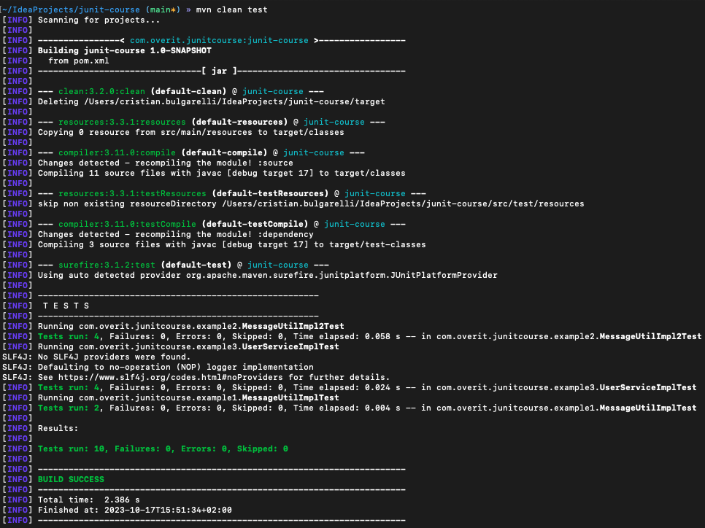
Here is an example of a test compilation launched from the terminal and completed successfully:
Cristian Bulgarelli - the source code is available at https://github.com/cBulgarelliAtWork/junit-course

Slide 26
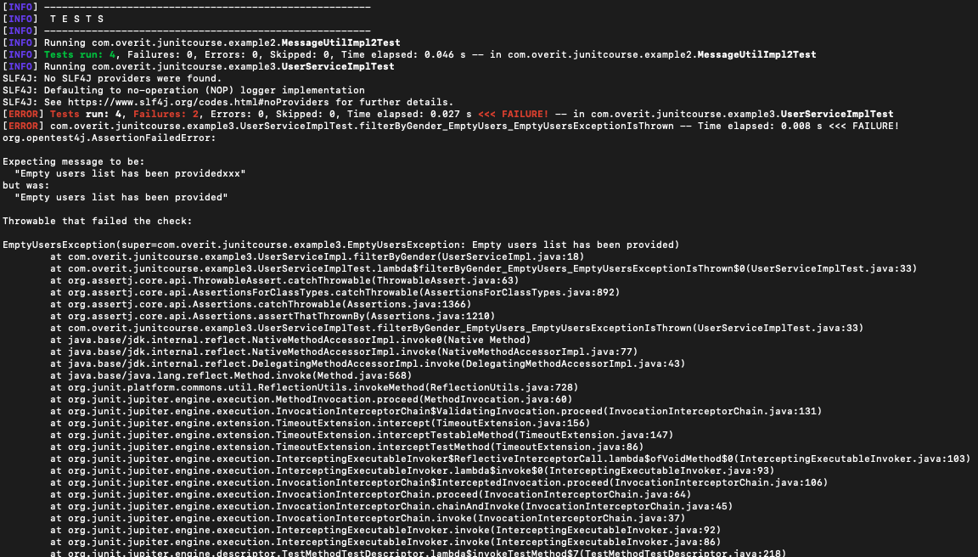
Here is another example of a test compilation launched from the terminal and failed:
Cristian Bulgarelli - the source code is available at https://github.com/cBulgarelliAtWork/junit-course

Slide 27
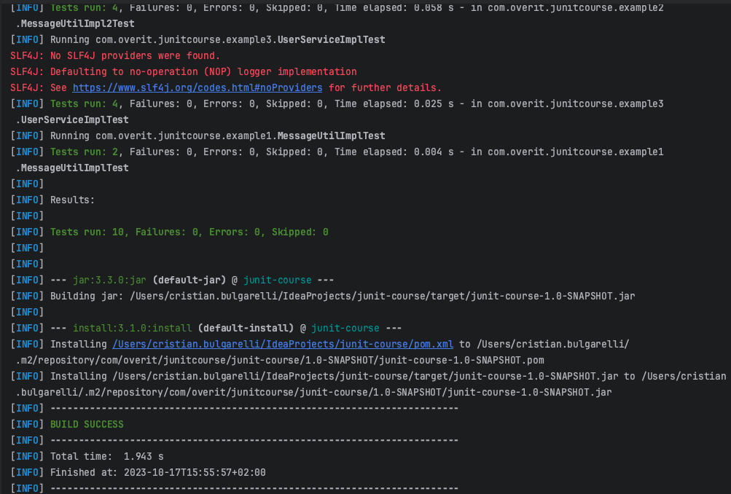
Here is an example of a test compilation launched from IntelliJ and completed successfully:
Cristian Bulgarelli - the source code is available at https://github.com/cBulgarelliAtWork/junit-course

Slide 28
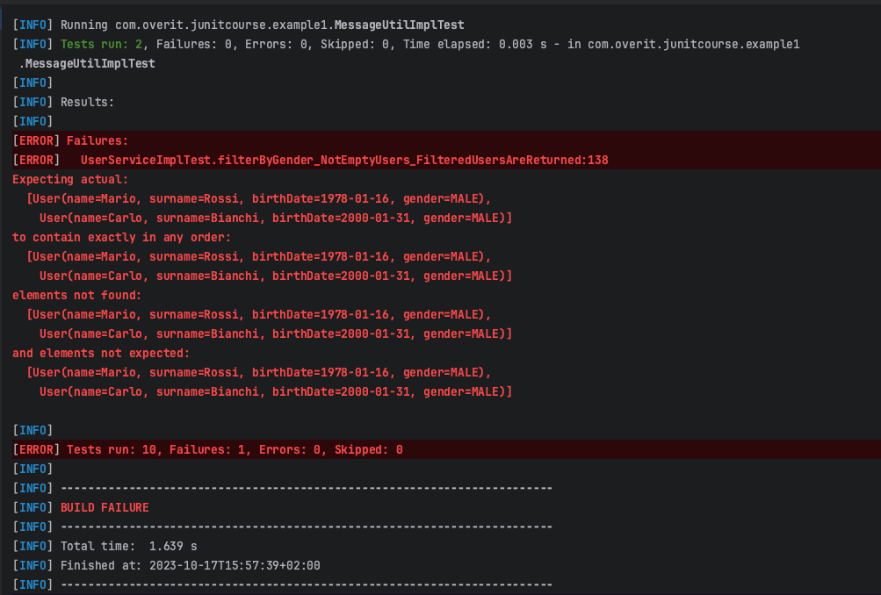
Here is another example of a test compilation launched from IntelliJ and failed:
Cristian Bulgarelli - the source code is available at https://github.com/cBulgarelliAtWork/junit-course

Slide 29
Easy-random
The Easy-random dependency has been widely used, it is a library that generates random Java objects. Let's say you have a class Person and you want to generate a random instance of it, here we go:
EasyRandom easyRandom = new EasyRandom();
Person person = easyRandom.nextObject(Person.class);
In order to use this dependency, you will need to integrate it as follows within your project's pom.xml:
<dependency>
<groupId>org.jeasy</groupId>
<artifactId>easy-random-core</artifactId>
<version>5.0.0</version>
<scope>test</scope>
</dependency>
Cristian Bulgarelli - the source code is available at https://github.com/cBulgarelliAtWork/junit-course

Slide 30
The java.util.Random API provides 7 methods to generate random data: nextInt(), nextLong(), nextDouble(), nextFloat(), nextBytes(), nextBoolean() and nextGaussian(). What if you need to generate a random String? Or say a random instance of your domain object? Easy Random provides the EasyRandom API that extends java.util.Random with a method called nextObject(Class type). This method is able to generate a random instance of any arbitrary Java bean.
Here are some example of randomly generated objects:
EasyRandom easyRandom = new EasyRandom();
Person person = easyRandom.nextObject(Person.class);
String name = easyRandom.nextObject(String.class);
Integer age = easyRandom.nextInt();
Boolean valid = easyRandom.nextBoolean();
Company company = easyRandom.nextObject(Company.class);
User user = easyRandom.nextObject(User.class);
Cristian Bulgarelli - the source code is available at https://github.com/cBulgarelliAtWork/junit-course

Slide 31
The EasyRandomParameters class is the main entry point to configure EasyRandom instances. It allows you to set all parameters to control how random data is generated:
EasyRandomParameters parameters = new EasyRandomParameters()
.seed(123L) // EasyRandom can be configured with a seed in order to generate the same random instances
.objectPoolSize(100) // When a type declares a field of the same type, Easy Random will not be able to generate a random object graph due to infinite recursion
.randomizationDepth(3) // The randomizationDepth allows you to limit the randomization depth in an object graph
.charset(forName("UTF-8")) // You can use the charset parameter to generate random values from the specified Charset in all character-based fields
.timeRange(nine, five) // You can use the dateRange and timeRange parameters to generate Date and Time values in a given range
.dateRange(today, tomorrow) // You can use the dateRange and timeRange parameters to generate Date and Time values in a given range
.stringLengthRange(5, 50) // Setting the stringLengthRange parameter tells Easy Random to generate random strings with a bounded size.
.collectionSizeRange(1, 10) // The collectionSizeRange parameter lets you bound the generated collections size
.scanClasspathForConcreteTypes(true) // This parameter tells Easy Random to scan the classpath and look for a concrete type of the abstract/interface field
.overrideDefaultInitialization(false). // To override the default initialization of generated random bean fields
.ignoreRandomizationErrors(true); // With this parameter set, any exception raised during the randomization process will be silently ignored
EasyRandom easyRandom = new EasyRandom(parameters);
In most cases, default options are enough and you can use the default constructor of EasyRandom.
Cristian Bulgarelli - the source code is available at https://github.com/cBulgarelliAtWork/junit-course

Slide 32
It is also possible to customize the way in which some fields of a bean will be managed during the random generation phase of that bean. In the following example we instruct Easy-random to exclude the id and task fields when randomly generating a JobExecution bean:
EasyRandomParameters parameters = new EasyRandomParameters()
.excludeField(FieldPredicates.named("task").and(FieldPredicates.inClass(JobExecution.class)))
.excludeField(FieldPredicates.named("id").and(FieldPredicates.inClass(JobExecution.class)));
easyRandom = new EasyRandom(parameters);
Easy-random also provides various implementations of Randomizer, with which to generate random objects, even complex ones. The following example uses MapRandomizer and StringRandomizer to generate a random Map<String, Object>:
Map<String, Object> src = new MapRandomizer<>(new StringRandomizer(), () -> easyRandom.nextObject(Object.class)).getRandomValue();
Cristian Bulgarelli - the source code is available at https://github.com/cBulgarelliAtWork/junit-course

Slide 33
Mockito
So far we have tested a completely independent service, but the reality is often much more complicated. Typically most of our services will themselves depend on other services. They will receive services instances on which they depend and will delegate them at the appropriate time.
It is important to underline, however, that the purpose of unit tests is exclusively to test a single class, to ensure that it works as expected. Everything outside the class under test is not the subject of the test.
We therefore need a mechanism to mock the behavior of all dependencies external to the test, so as to be able to simulate their behavior and verify that the class under test acts according to expectations.
Mockito is a library that allows us to achieve this goal! We could mock all the dependencies external to our test, instruct mockito on the behavior that these dependencies should have in the various test methods, and verify that our class under test works as we expect.
Cristian Bulgarelli - the source code is available at https://github.com/cBulgarelliAtWork/junit-course

Slide 34
In order to use this dependency, you will need to integrate it as follows within your project's pom.xml:
<dependency>
<groupId>org.mockito</groupId>
<artifactId>mockito-core</artifactId>
<version>5.6.0</version>
<scope>test</scope>
</dependency>
<dependency>
<groupId>org.mockito</groupId>
<artifactId>mockito-junit-jupiter</artifactId>
<version> 5.6.0 </version>
<scope>test</scope>
</dependency>
Cristian Bulgarelli - the source code is available at https://github.com/cBulgarelliAtWork/junit-course

Slide 35
Suppose we have the following class to test:
package com.overit.junitcourse.example4;
import com.overit.junitcourse.example3.User;
import java.util.List;
/**
* Service useful to send newsletters.
*/
public interface NewsletterSendingService {
/**
* Sends a newsletter to the provided {@code recipient} men.<br>
* Returns {@code true} in case of success; {@code false} otherwise.
*
* @param recipients {@link List}&lt;{@link User}&gt; about the recipients.
* @param subject {@link String} about the e-mail subject.
* @param body {@link String} about the e-mail body.
* @return {@code true} in case of success; {@code false} otherwise.
* @throws NewsletterSendingException exception thrown in case of problem occurred while sending the newsletter.
*/
boolean sendNewsletterToMen(List<User> recipients, String subject, String body) throws NewsletterSendingException;
}
Cristian Bulgarelli - the source code is available at https://github.com/cBulgarelliAtWork/junit-course

Slide 36
package com.overit.junitcourse.example4;
…
public class NewsletterSendingServiceImpl implements NewsletterSendingService {
…
private final UserService userService;
private final EmailSendingService emailSendingService;
private final EmailValidator emailValidator;
@Override
public boolean sendNewsletterToMen(@NonNull List<User> recipients, @NonNull String subject, @NonNull String body) throws NewsletterSendingException {
log.debug("sendNewsletterToMen(recipients={}, subject={}, body={})", recipients, subject, body);
boolean[] result = {true};
try {
// I only keep men from the list provided
List<User> menRecipients = userService.filterByGender(Gender.MALE, recipients);
log.debug("validating {} users", menRecipients.size());
menRecipients.forEach(recipient -> validateEmail(recipient.getEmail()));
log.debug("sending the newsletter to {} users", menRecipients.size());
menRecipients.forEach(recipient -> result[0] &= emailSendingService.sendEmail(SENDER_EMAIL, recipient.getEmail(), subject, body));
} catch (EmptyUsersException ex) {
throw new NewsletterSendingException(EMPTY_USERS_LIST_HAS_BEEN_PROVIDED, ex);
} catch (NoUsersFoundException ex) {
throw new NewsletterSendingException(NO_USERS_HAVE_BEEN_FOUND, ex);
} catch (InvalidEmailException ex) {
throw new NewsletterSendingException(INVALID_E_MAIL_FOUND, ex);
}
log.debug("result is {}", result[0]);
return result[0];
}
}
Cristian Bulgarelli - the source code is available at https://github.com/cBulgarelliAtWork/junit-course

Slide 37
This class depends on three services on which it delegates: UserService, EmailSendingService, EmailValidator.
We would therefore need, when writing NewsletterSendingServiceImplTest, to use Mockito to mock the behavior of the services mentioned.
The first step is to notify the JUnit engine that we want to use Mockito. To do this it will be necessary to annotate the test class with the @ExtendWith annotation, as follows:
@ExtendWith(MockitoExtension.class)
class NewsletterSendingServiceImplTest {
}
The next step will be to create a member variable for each service to be mocked, and warn Mockito that it will have to manage these services for us. To do this you will need to decorate each service with the @Mock annotation, as shown below:
@Mock
private UserService userService;
@Mock
private EmailSendingService emailSendingService;
@Mock
private EmailValidator emailValidator;
Cristian Bulgarelli - the source code is available at https://github.com/cBulgarelliAtWork/junit-course

Slide 38
At this point we need to instantiate our class (inside the @BeforeEach method) using its constructor with the mocked instances of the services. Or we can entrust this task to Mockito, decorating our sut variable (relative to the instance of the class under test) with the @InjectMock annotation, as shown below:
@InjectMocks
private NewsletterSendingServiceImpl sut;
Now we can use Mockito within each test method, to simulate one of the possible behaviors of the external services, while verifying that the class under test behaves according to expectations.
Below are some examples of use of the Mockito framework:
Mockito.when(mock.someMethod()).thenReturn(10);
In this example, we ask Mockito to return 10 when the someMethod() method is invoked on a mock service.
Mockito.when(mock.someMethod()).thenThrow(new RuntimeException());
In this example, we ask Mockito to throw a RuntimeException when the someMethod() method is invoked on a mock service.
Cristian Bulgarelli - the source code is available at https://github.com/cBulgarelliAtWork/junit-course

Slide 39
How do we mock a void method instead? Here are a couple of examples:
Mockito.doNothing().when(mock).someMethod();
In this example, we ask Mockito to do nothing when the someMethod() method is invoked on a mock service.
Mockito.doThrow(new RuntimeException()).when(mock).someMethod();
In this example, we ask Mockito to throw a RuntimeException when the someMethod() method is invoked on a mock service.
When we mock a method with arguments we have two possibilities:
we specify the value of each argument
we use Mockito's ArgumentMatchers to define mocks more flexibly
With the first possibility, the mock will only respond when specific input values are used; while with the second possibility we create mocks that respond to different combinations of input values.
Let's see some examples.
Cristian Bulgarelli - the source code is available at https://github.com/cBulgarelliAtWork/junit-course

Slide 40
when(userService.filterByGender(Gender.MALE, recipients)).thenThrow(expectedException);
In this example we are instructing Mockito to respond when the filterByGender(...) method is invoked with two specific arguments: Gender.MALE and recipients. This means that if the filterByGender(...) method was invoked with values other than those mentioned, the mock would not respond.
when(userService.filterByGender(any(Gender.class), anyList())).thenThrow(expectedException);
In this example we are instructing Mockito to respond when the filterByGender(...) method is invoked with any value of Gender and any list of User. Compared to the mock defined on specific arguments, this mock based on Mockito's ArgumentMatchers covers several more use cases.
The org.mockito.ArgumentMatchers class provides many argument matchers that can be very useful when writing tests. Below are the most used:
org.mockito.ArgumentMatchers.any(): Matches anything, including nulls
org.mockito.ArgumentMatchers.any(Class<T> type): Matches any object of given type, excluding nulls
org.mockito.ArgumentMatchers.anyBoolean(): Any boolean or non-null Boolean
org.mockito.ArgumentMatchers.anyByte(): Any byte or non-null Byte
org.mockito.ArgumentMatchers.anyChar(): Any char or non-null Character
org.mockito.ArgumentMatchers.anyInt(): Any int or non-null Integer
org.mockito.ArgumentMatchers.anyLong(): Any long or non-null Long
org.mockito.ArgumentMatchers.anyFloat(): Any float or non-null Float
org.mockito.ArgumentMatchers.anyDouble(): Any double or non-null Double
Cristian Bulgarelli - the source code is available at https://github.com/cBulgarelliAtWork/junit-course

Slide 41
org.mockito.ArgumentMatchers.anyShort(): Any short or non-null Short
org.mockito.ArgumentMatchers.anyString(): Any non-null String
org.mockito.ArgumentMatchers.anyList(): Any non-null List
org.mockito.ArgumentMatchers.anySet(): Any non-null Set
org.mockito.ArgumentMatchers.anyMap(): Any non-null Map
org.mockito.ArgumentMatchers.anyCollection(): Any non-null Collection
org.mockito.ArgumentMatchers.eq(boolean value): boolean argument that is equal to the given value
org.mockito.ArgumentMatchers.eq(byte value): byte argument that is equal to the given value
org.mockito.ArgumentMatchers.eq(char value): char argument that is equal to the given value
org.mockito.ArgumentMatchers.eq(double value): double argument that is equal to the given value
…
org.mockito.ArgumentMatchers.isNull(): null argument
org.mockito.ArgumentMatchers.isNull(Class<T> type): null argument
org.mockito.ArgumentMatchers.notNull(): not null argument
org.mockito.ArgumentMatchers.notNull(Class<T> type): not null argument
org.mockito.ArgumentMatchers.nullable(Class<T> type): Argument that is either null or of the given type
org.mockito.ArgumentMatchers.startsWith(String prefix): String argument that starts with the given prefix
org.mockito.ArgumentMatchers.endsWith(String suffix): String argument that ends with the given suffix
Cristian Bulgarelli - the source code is available at https://github.com/cBulgarelliAtWork/junit-course

Slide 42
It is important to remember that, when defining mocks, it is possible to mock a method with only specific arguments or with only argument matchers, mixed use is not allowed.
So the following code, which uses both specific values and argument matchers, is invalid:
when(userService.filterByGender(Gender.MALE, anyList())).thenThrow(expectedException);
Cristian Bulgarelli - the source code is available at https://github.com/cBulgarelliAtWork/junit-course

Slide 43
Mockito not only offers the possibility of mocking the behavior of methods, but also the possibility of making assertions about whether or not these methods have been called, how many times and with which arguments.
So in the then section of our test we could also check if and how the mocked methods were called during the test. The most important method for making these assertions is org.mockito.Mockito#verify(T).
Below is an example:
verify(userService).filterByGender(Gender.MALE, recipients);
In the example above we are assuming that the filterByGender(...) method was called once, with the Gender.MALE and recipients arguments.
The verify(…) method takes as its first argument the mocked class instance (mock), and possibly as its second argument the number of times the mocked method must have been called.
If the number of times is not matched, the test will fail.
Below are other examples of using verify(…):
Cristian Bulgarelli - the source code is available at https://github.com/cBulgarelliAtWork/junit-course

Slide 44
Below are other examples of using verify(…):
verify(userService).filterByGender(Gender.MALE, recipients); // method filterByGender(…) called once, with the values Gender.MALE and recipients
verify(userService, times(3)).filterByGender(Gender.MALE, recipients); // method filterByGender(…) called three times, with the values Gender.MALE and recipients
verify(userService, atLeastOnce()).filterByGender(Gender.MALE, recipients); // method filterByGender(…) called at least once, with the values Gender.MALE and recipients
verify(userService, never()).filterByGender(any(Gender.class), anyList()); // method filterByGender(…) never called, with any value
As you can see, the verify(...) method also supports the use of argument matchers.
Cristian Bulgarelli - the source code is available at https://github.com/cBulgarelliAtWork/junit-course

Slide 45
Mockito – mocking static methods
It is also possible to define mocks on static methods, although slightly more complicated. An instance of org.mockito.MockedStatic is created, via the org.mockito.Mockito#mockStatic(java.lang.Class<T>) method, typically within a try-with-resources block.
Here is an example of how to mock the static Gender.of(String) method:
try (MockedStatic<Gender> mockedGender = mockStatic(Gender.class)) { // static mock creation
mockedGender.when(() -> Gender.of(genderAsString)).thenReturn(gender); // mocking static method call
// when
sut.gender(genderAsString);
User actual = sut.build();
// then
assertThat(actual).isNotNull()
.usingRecursiveComparison()
.isEqualTo(expected);
mockedGender.verify(() -> Gender.of(genderAsString)); // assertion on static method call
}
Cristian Bulgarelli - the source code is available at https://github.com/cBulgarelliAtWork/junit-course

Slide 46
Mockito Spy
As mentioned above, unit tests should focus on testing only the behavior of a class under test. In particular, each @Test method of a JUnit class will test only one method of the class under test. If the method under test called another method of the same class, this called method should be considered as an external dependency. Consequently the called method should be mocked.
But how can you only partially mock the class under test? By creating a Mockito Spy, via the org.mockito.Mockito#spy(T) method or the org.mockito.Spy annotation.
Once the spy has been created, calls to its methods will execute the real methods, unless they have previously been mocked using the pattern already seen.
Below is an example of creating a spy object:
@Spy
@InjectMocks
private NewsletterSendingServiceImpl spiedSut;
@Mock
private UserService userService;
@Mock
private EmailSendingService emailSendingService;
@Mock
private EmailValidator emailValidator;
Cristian Bulgarelli - the source code is available at https://github.com/cBulgarelliAtWork/junit-course

Slide 47
Important gotcha on spying real objects!
Sometimes it's impossible or impractical to use Mockito.when(Object) for stubbing spies. Therefore for spies it is recommended to always use doReturn|Answer|Throw()|CallRealMethod family of methods for stubbing.
Example:
List list = new LinkedList();
List spy = spy(list);
// Impossible: real method is called so spy.get(0) throws IndexOutOfBoundsException (the list is yet empty)
when(spy.get(0)).thenReturn("foo");
// You have to use doReturn() for stubbing
doReturn("foo").when(spy).get(0);
Cristian Bulgarelli - the source code is available at https://github.com/cBulgarelliAtWork/junit-course

Slide 48
Below is an example of a test that uses the Mockito Spy mechanism. The sendNewsletterToMen(...) method under test internally calls the validateEmail(String) method. This last method is spied on to mock its behavior.
@Test
void sendNewsletterToMen_ValidateEmailThrowsInvalidEmailException_ANewsletterSendingExceptionIsThrown() {
// given
List<User> recipients = easyRandom.objects(User.class, 3).toList();
List<User> menRecipients = easyRandom.objects(User.class, 3).toList();
String subject = easyRandom.nextObject(String.class);
String body = easyRandom.nextObject(String.class);
InvalidEmailException expectedException = easyRandom.nextObject(InvalidEmailException.class);
when(userService.filterByGender(Gender.MALE, recipients)).thenReturn(menRecipients);
doThrow(expectedException).when(spiedSut).validateEmail(menRecipients.get(0).getEmail()); // the spied method validateEmail(…) is mocked
// when
assertThatThrownBy(() -> spiedSut.sendNewsletterToMen(recipients, subject, body)) // the method sendNewsletterToMen(..) has not been mocked
.isInstanceOf(NewsletterSendingException.class)
.hasMessage(INVALID_E_MAIL_FOUND)
.hasRootCause(expectedException);
// then
verify(userService).filterByGender(Gender.MALE, recipients);
verify(spiedSut).validateEmail(menRecipients.get(0).getEmail()); // assertion on spied mocked method
verify(emailSendingService, never()).sendEmail(eq(SENDER_EMAIL), anyString(), anyString(), anyString());
}
Cristian Bulgarelli - the source code is available at https://github.com/cBulgarelliAtWork/junit-course

Slide 49

Thank You.

